Slide 1
Look up! How to practically live-out your identity in Christ
Glynn Harrison

Slide 2
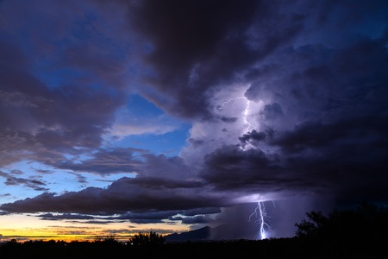
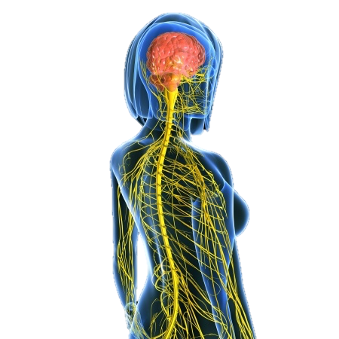
‘See what great love the Father has lavished on us, that we should be called children of God. And that is what we are.’ (1 John 3: 1)

Slide 3
A Father’s:
Image
Worth
Approval
Patience

Slide 4
“But if you are a poor creature – poisoned by a wretched upbringing in some house full of vulgar jealousies and senseless quarrels – saddled, by no choice of your own, with some loathsome sexual [problem] – nagged day in and day out by an inferiority complex that makes you snap at your best friends – do not despair. He knows all about it. You are one of the poor whom he blessed. He knows what a wretched machine you are trying to drive. Keep on. Do what you can. One day he will sling it on the scrapheap and give you a new one. And then you may astonish as all – not least yourself: for you have learned your driving in a hard school”
Mere Christianity. C.S Lewis

Slide 5
Harrison, G (2016) Who am I today? The Modern Crisis of Identity.
Cambridge Papers, Jubilee centre
Harrison, G (2013) The Big Ego Trip (IVP)
Harrison G (2017) A Better Story: God, sex and human flourishing (IVP)
Rosner B.S (2022) Known by God: a biblical theology of personal identity. Zondervan
Sprinkle P (2022) Embodied: transgender identities, the Church and what the Bible says’

Slide 6
