Slide 2
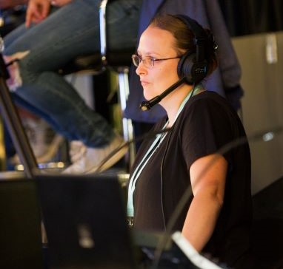
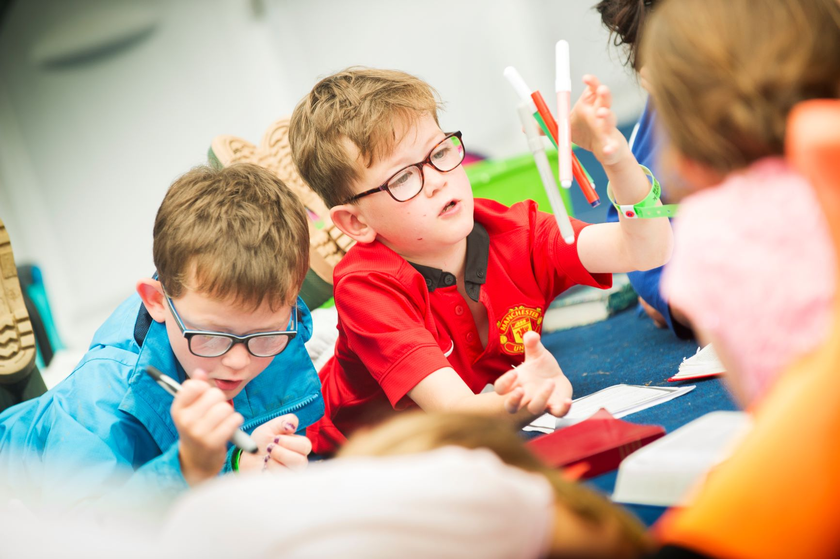
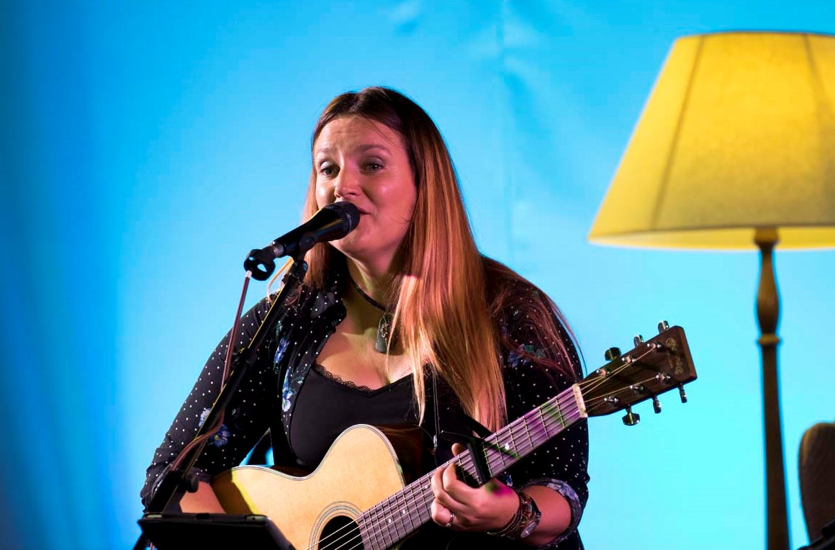
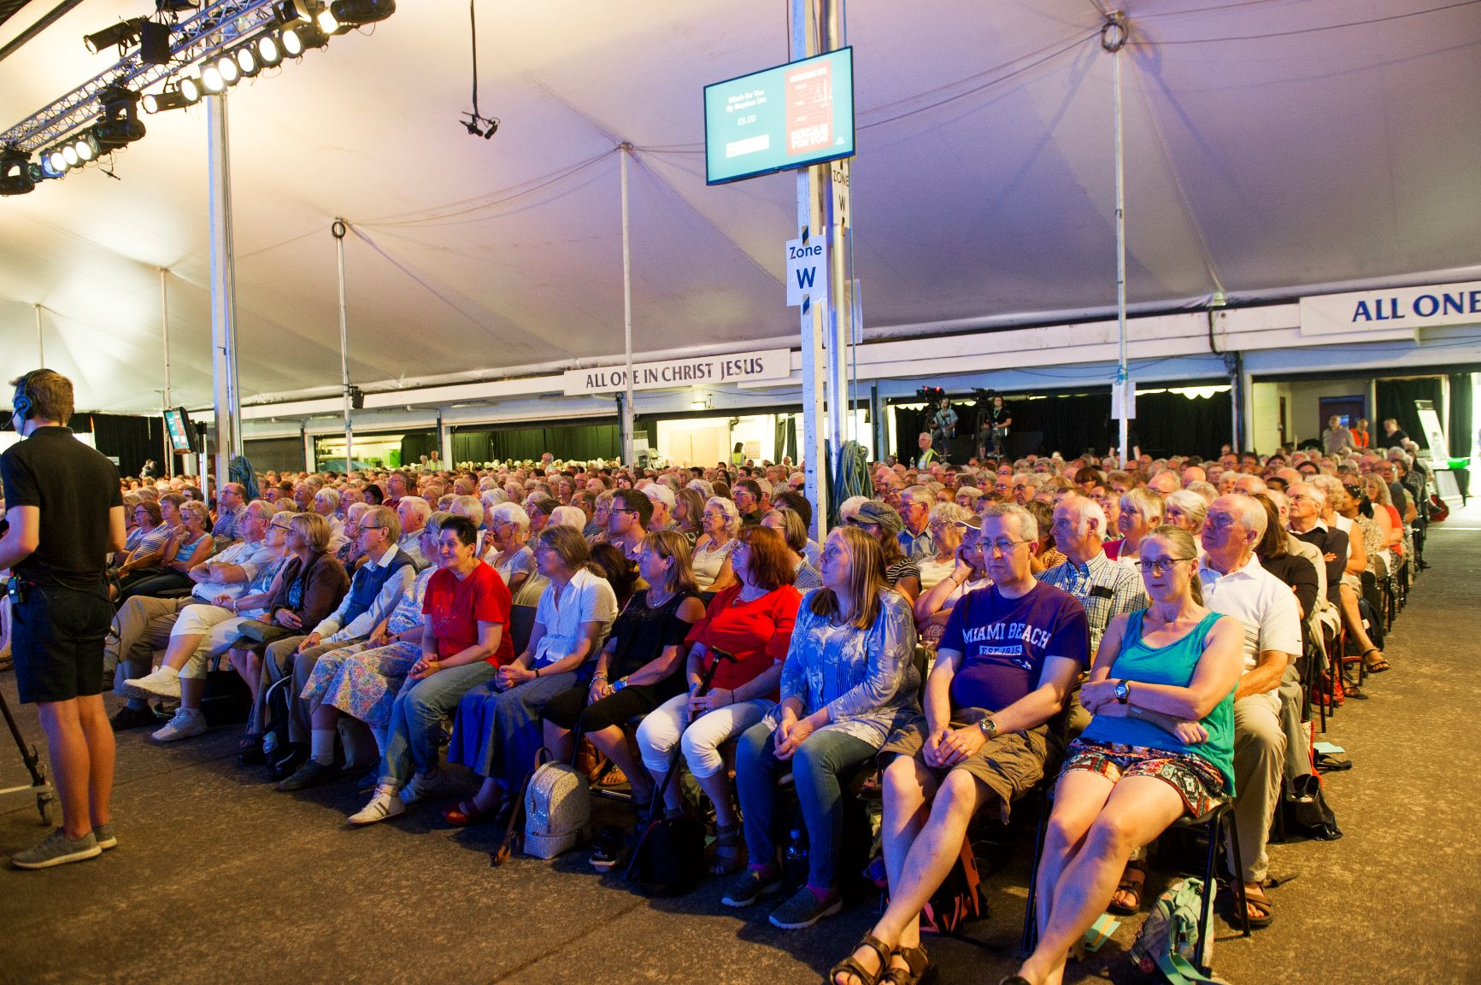
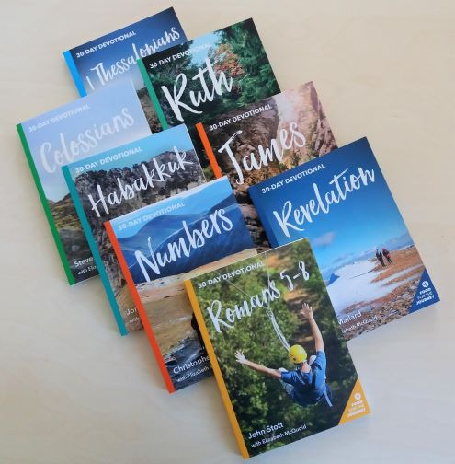
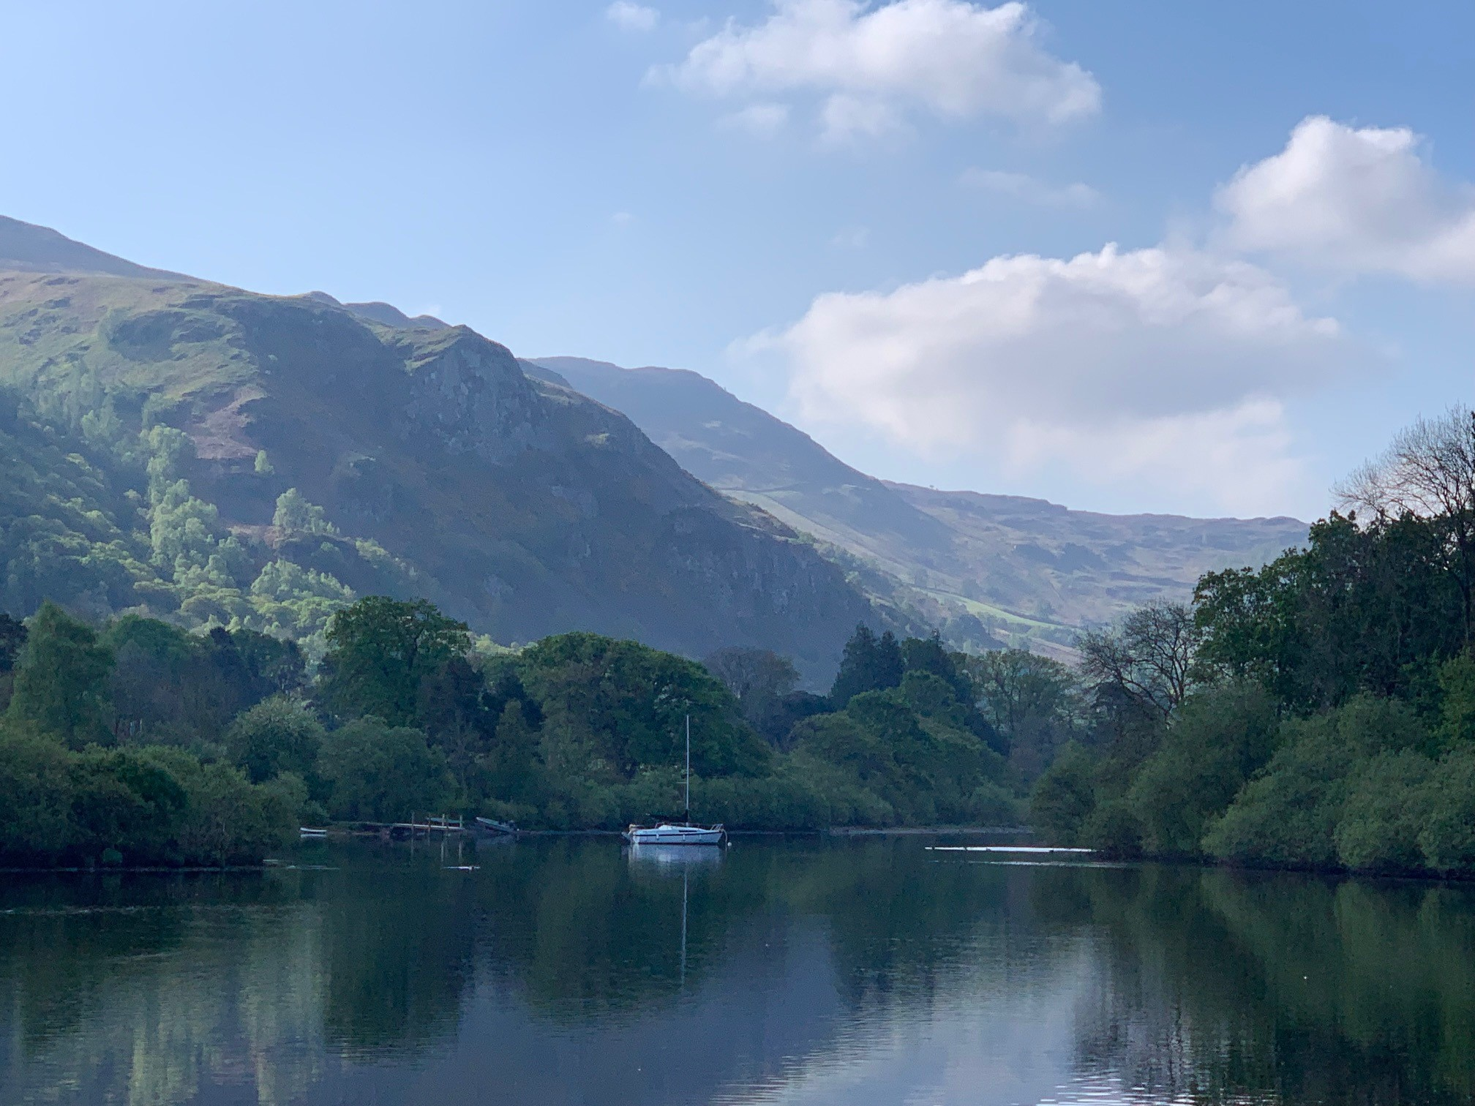
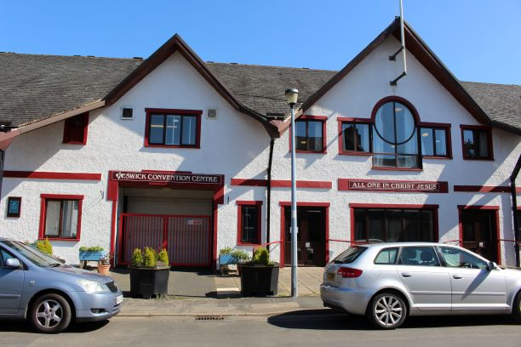
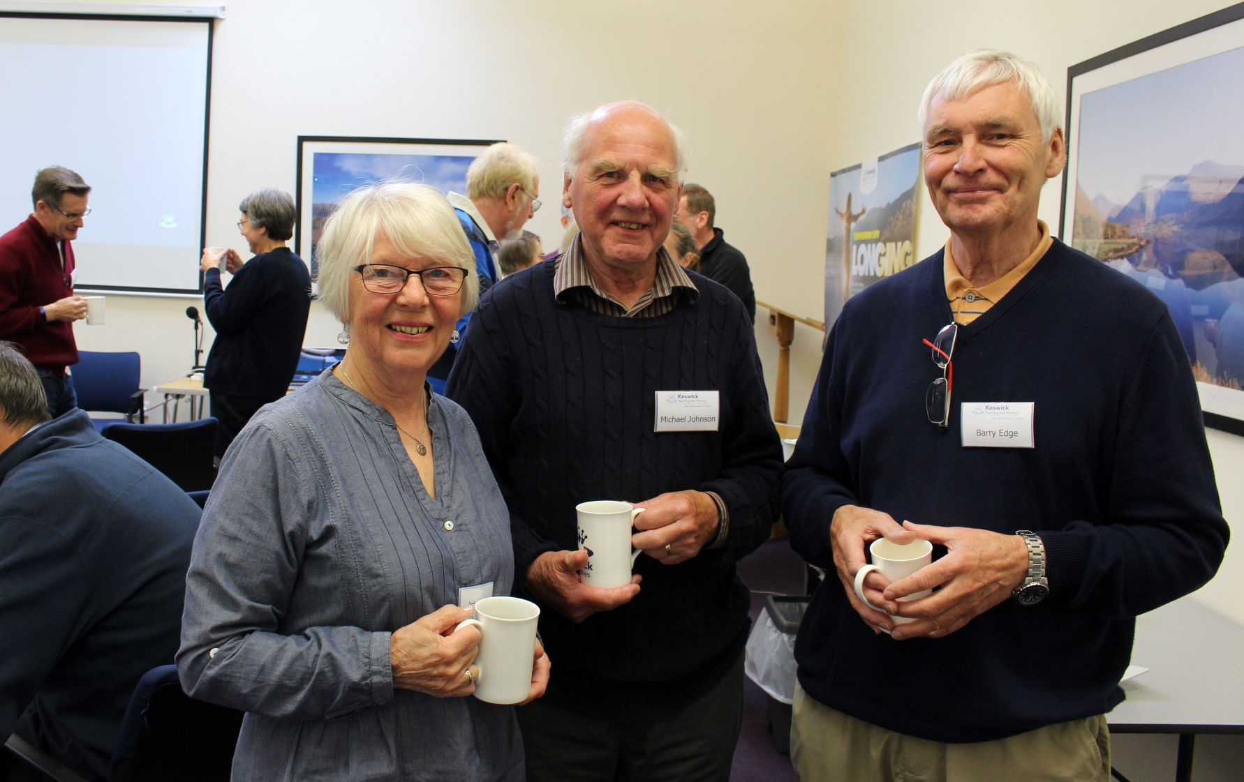
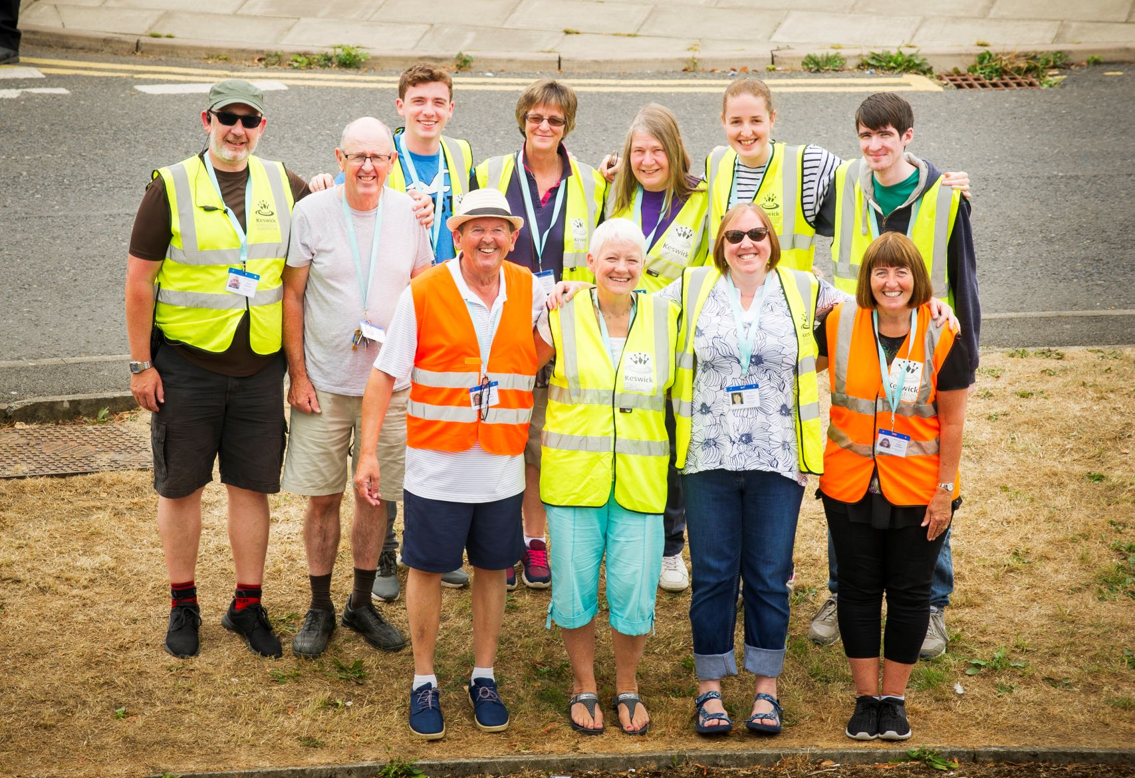
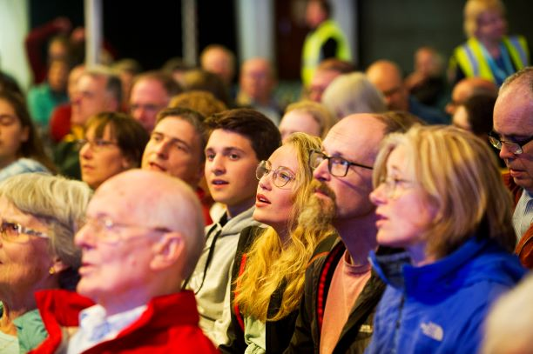
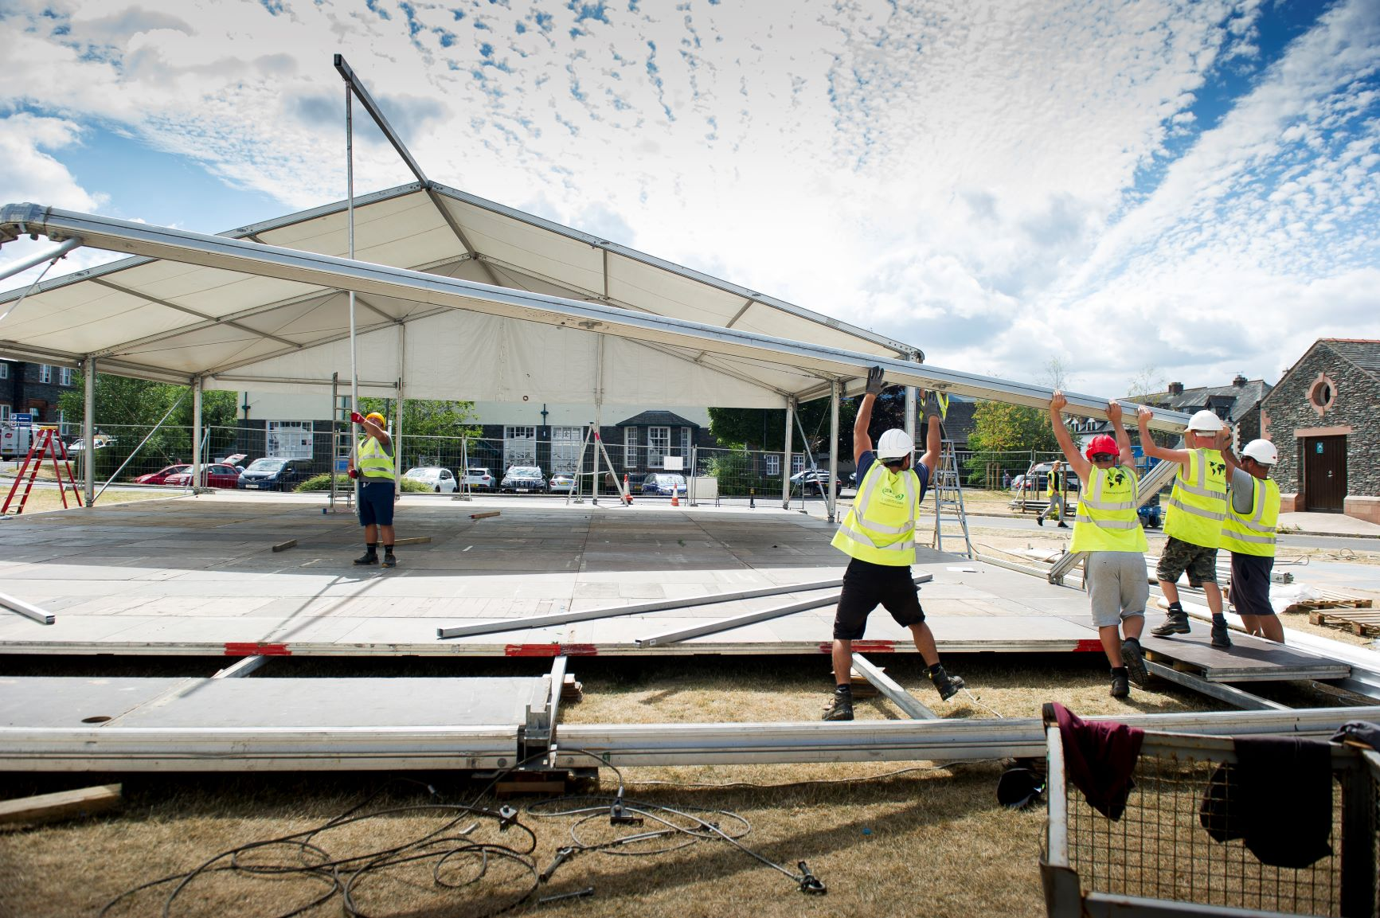
Prayer Day Wednesday 13 May 2020

Slide 3
Current situation
Give thanks to God that He is with us in all circumstances, He will never leave us nor forsake us. He is our comfort in difficult times.
Pray for all those affected by the spread of the Coronavirus. We pray for mercy. We pray especially that many would respond in repentance and faith to the preaching of the gospel of Jesus Christ.
Pray that the church would be a light of hope in these dark times.
Pray for those worried about their health and the health of loved ones. We give thanks that Jesus Christ is the same yesterday, today and for the ages to come.
Pray for those financially impacted by the effects of the Coronavirus, for mercy and for wisdom.
Give thanks to God that Virtually Keswick Convention (27- 31 July) has been planned following the cancellation of the usual Keswick Convention, due to Covid-19.
Please pray for us to continue to have a positive witness to the town – all year round – and especially as we plan a slightly different, virtual Convention

Slide 4
Virtually Keswick Convention
Pray as plans come together for holding Virtually Keswick Convention
Pray as there is a lot of practical and logistical needs, with numerous people working unseen. Please pray that all the details would come together well
Pray for plans for the ministry as the theme of Hope will be given at the virtual Convention: that God will undertake in the planning of those messages to be spoken.
Pray for protection for young people as they seek to learn more about our Lord.
Pray for the safety and wellbeing of contractors as they plan Virtually Keswick Convention
Pray for opportunities to bless those who usually work at other, non-Christian, events. Pray they would experience a Christ-filled atmosphere that make them question why we operate differently
Pray for the talented tech teams who manage all aspects of recordings, lighting, presentations and more. Pray that God would go before and prepare the way so all would run smoothly.

Slide 5
Volunteers
Give thanks for all the people who had applied to serve at Keswick Convention 2020: Give thanks for their servant hearts
Pray for God’s protection upon all those who faithfully volunteer at the Convention
Pray as work gets under way in planning Virtually Keswick Convention, that it will become clear what volunteer roles will be needed and that people with the right skill set will be able to take up the necessary roles
Pray as we look ahead to Keswick Convention 2021: That people will be looking forward to applying to serve on the new integrated site together

Slide 6
Speakers
Pray for all the contributors of the Convention, particularly for Christopher Ash, giving Bible Readings on Hope in Jesus from the Psalms
Pray for their talks
Pray for their strength and safety
Pray for their families as they support them in this task
Pray that their focus would be on the Word of God and on serving those who come to the Convention
Children, youth and young adults
Pray that the children, youth & young adults would be inspired about God
Pray that they would gain a wonderful love for the Word of God
Pray that the Lord would draw near to them

Slide 7
Finances
Give thanks for the generosity of His people, throughout the year, which makes it possible to hold Virtually Keswick Convention.
Pray the Keswick Ministries will continue to be good stewards of the money we receive

Slide 8
Keswick Unconventional
Give thanks to God for all those involved in the Keswick Unconventional Programme
Pray that people would be drawn to the gospel through the various artistic expressions of the Word of God
Resources
Please pray that the Keswick Ministries resources would help people meet with God in his Word and grow as disciples.
Those with disabilities
Pray that the Lord would pave the way for them to enjoy the Convention without difficulty.

Slide 9
The Derwent Project
Give thanks to the Lord Jesus for his faithfulness.
Give thanks to God that work has started on the Pencil Factory including windows taken out ready to be replaced and areas have been cleared inside.
Give thanks for the volunteers who have given up their time to help on the site.
Thank Jesus Christ that we can trust Him for the future.
Please pray for safety of the teams working on the site.
Please pray that the integrated site will be ready for 2021.
Pray for continued fundraising.
Pray that God’s will would be done.

Slide 10
Teaching & Training Programme
Give thanks for the teaching and training events that have taken place during the last year and the positive response they have received from participants.
Pray for the planning of next year's programme of teaching and training.
Pray for the speakers who will be teaching at upcoming events as they plan and prepare.
Online Influential Leadership Workshop (18th-22nd May)
Bible workshops in Hebrew (17th and 24th June)
Pray for those who will be attending these events that they will be blessed by what they hear and are able to take away and use what they learn to encourage and equip others.

